Slide 1
Lab 2
Electron portion, based on TG25

Slide 2
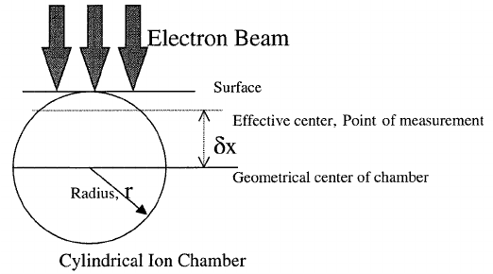
Cylindrical chamber shifts
For a cylindrical chamber the effective point of measurement is displaced towards the source from the centre of the chamber.
The magnitude of this displacement has been measured by using thin parallel-plate chambers, film dosimeters, or Fricke dosimeters in thin vessels and by suing a series of cylindrical probes of decreasing radii.

Slide 3
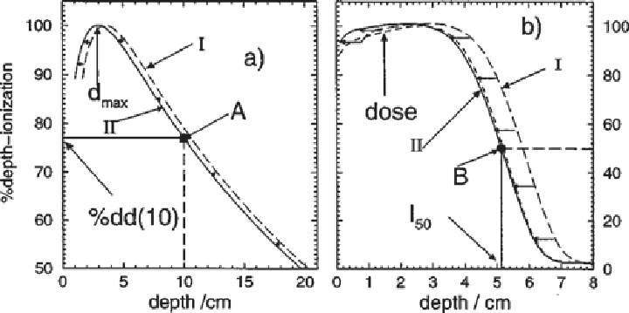
Cylindrical chamber shifts
Shift : 0.5 r_{cav} : electrons
0.6 r_{cav}: photons
You can either apply this shift to the chamber while taking the measurement (as we did in the lab) or you can correct for the shift when processing the data (shown here).

Slide 4
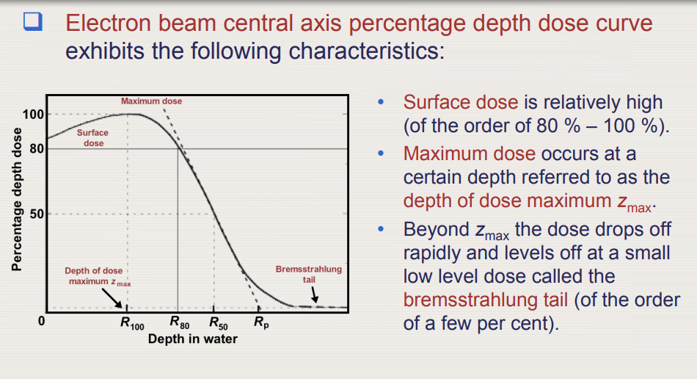
Electron PDD

Slide 5
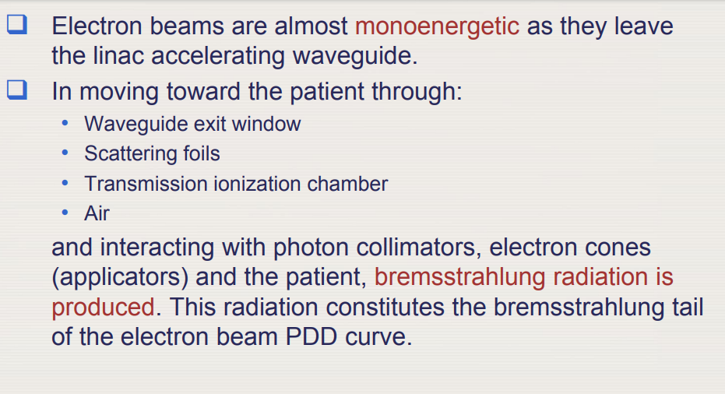
Electron ENERGY

Slide 6
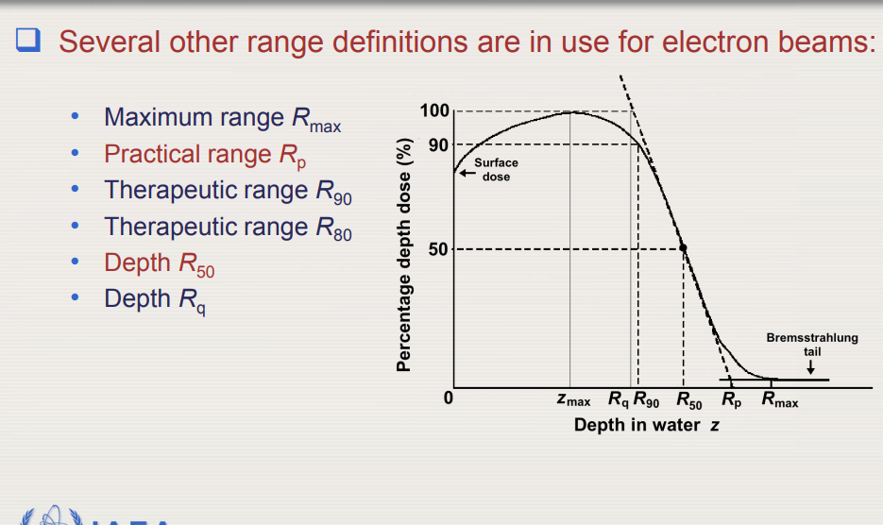
Electron PDD

Slide 7
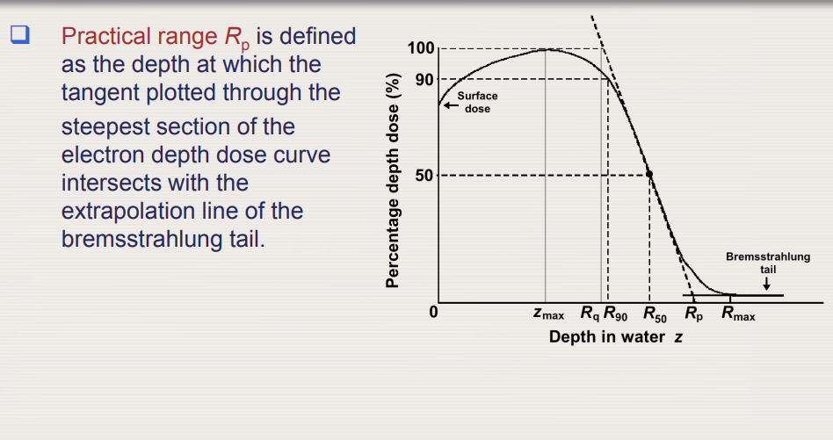
Practical Range

Slide 8
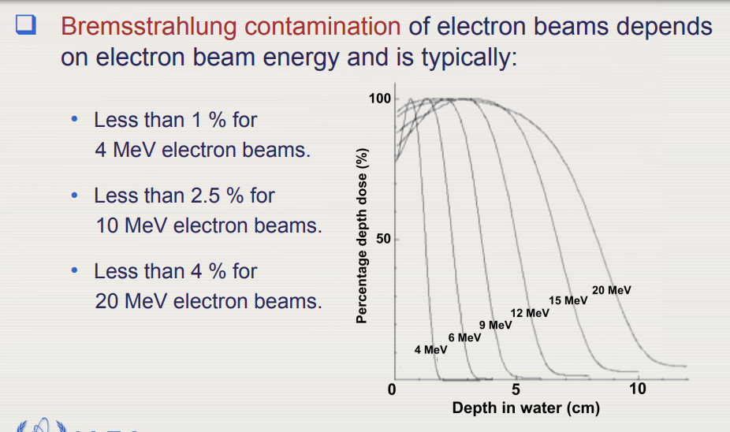
Bremsstrahlung Contamination

Slide 9
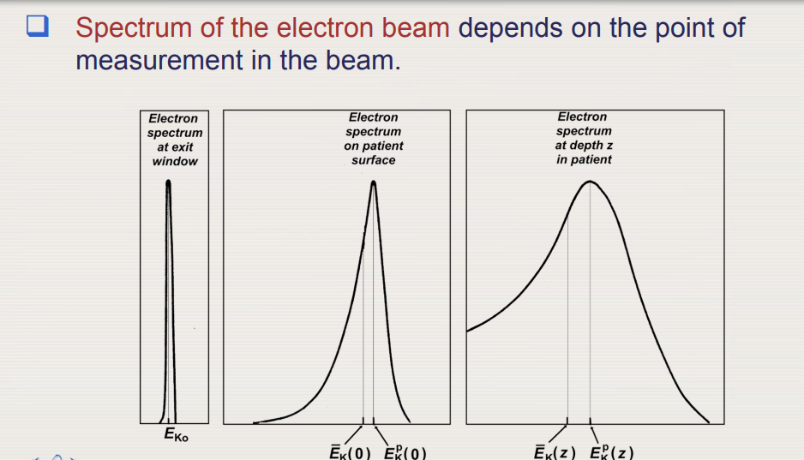
Electron energy

Slide 10
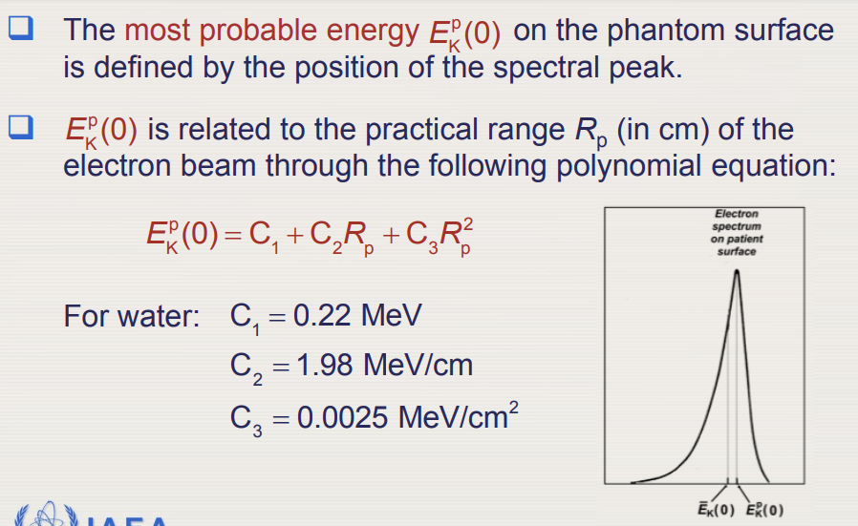
Most probable energy

Slide 11
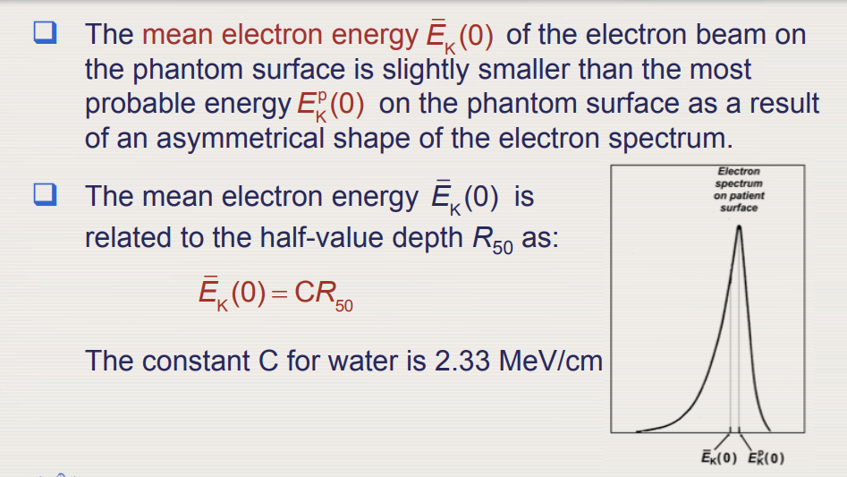
Mean energy

Slide 12
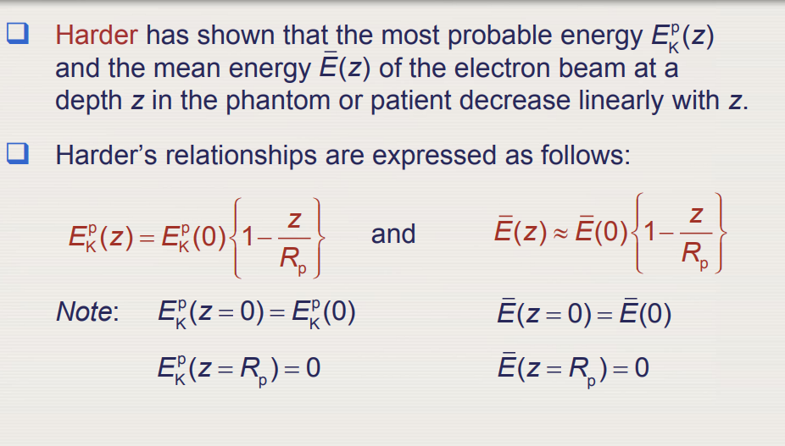
Energy at depth

Slide 13
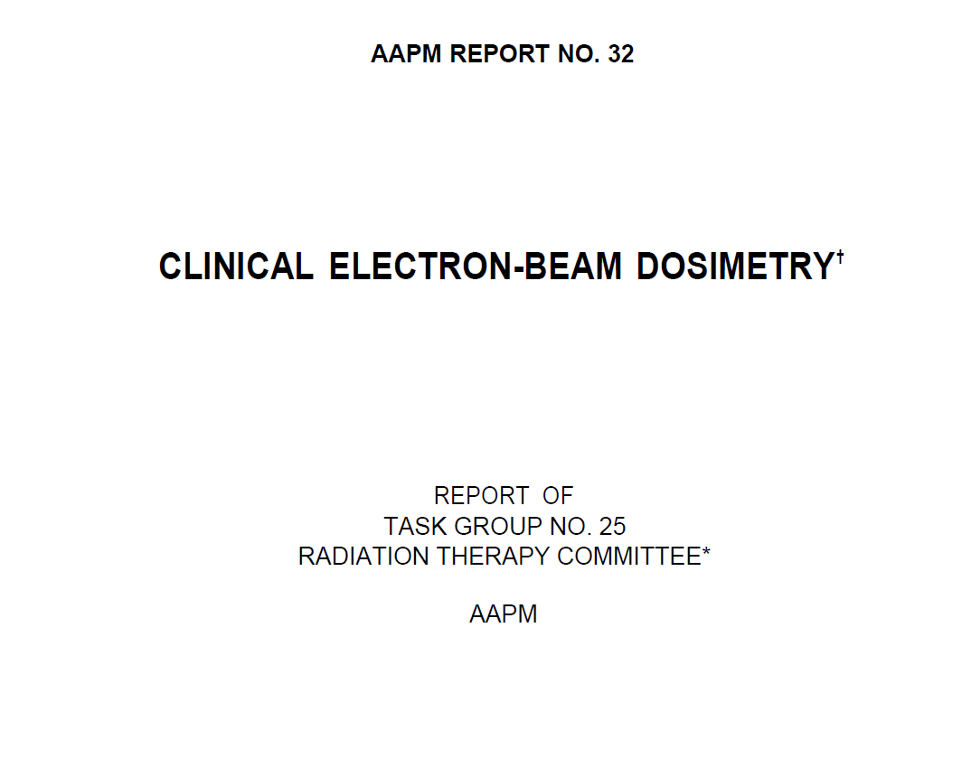

Slide 14
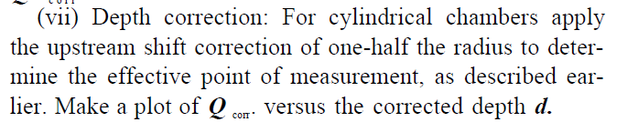
Converting PDI to PDD : shift

Slide 15
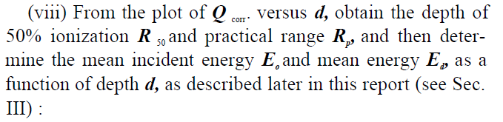

Converting PDI to PDD : energy at depth
Strictly speaking, to find mean energy at depth or surface we need R_{p} and R₅₀ from PDDs. In practice finding these values on the PDI graph is almost equivalent (within 1 mm).

Slide 16
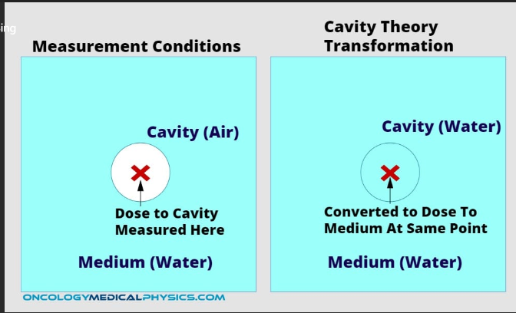
Converting PDI to PDD : Stopping power ratio
Remember that with ionization chambers, we are collecting ionization in the air cavity of the chamber.
Cavity theory
In its simplest form, relates the ionization in air to dose in medium.
Bragg-Gray: Ratio of doses in two media = ratio of stopping powers

Slide 17
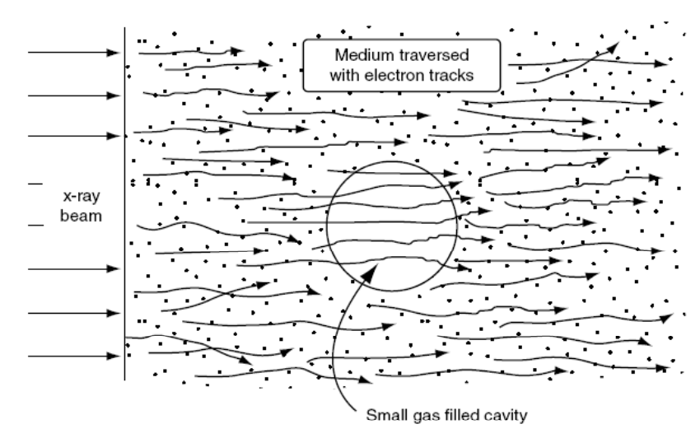
Converting PDI to PDD : Stopping power ratio
Assumptions in BG:
The cavity must not disturb the charged particle fluence existing in the medium in the absence of the cavity.
The absorbed dose in the cavity is deposited entirely by the charged particles crossing it.

Slide 18
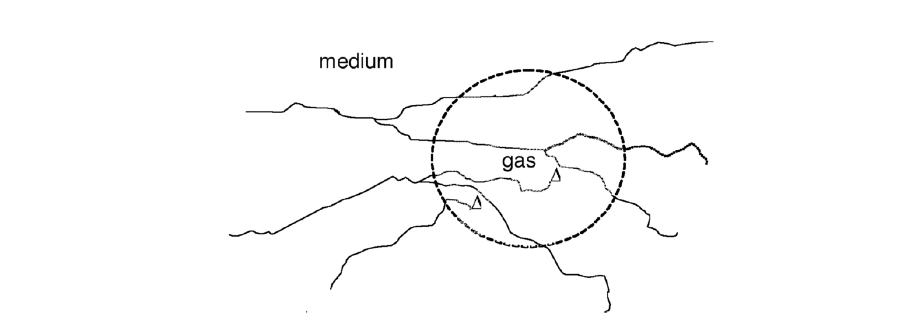
Converting PDI to PDD : Stopping power ratio
Spencer-Attix noticed that Bragg-Gray overestimates dose in the medium.
Electrons with energies less than 10 KeV do not have enough energy to cross over to the other side of normal ion chambers (r_{cav} 3-6 mm). Therefore, all of their energy is deposited locally.
The difference between BG and SA is the use of restricted stopping power ratios (medium/air) rather than unrestricted stopping power ratios.

Slide 19
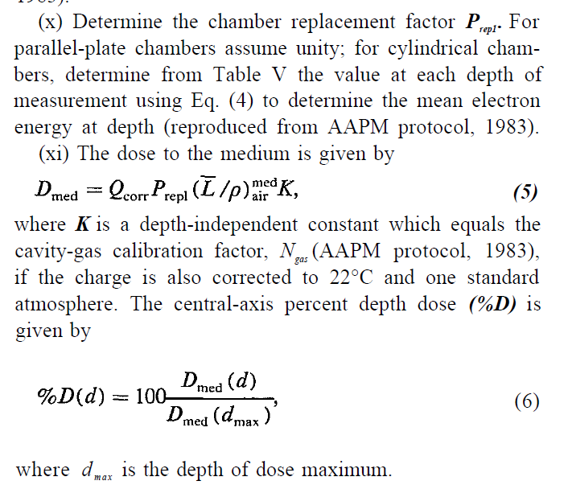
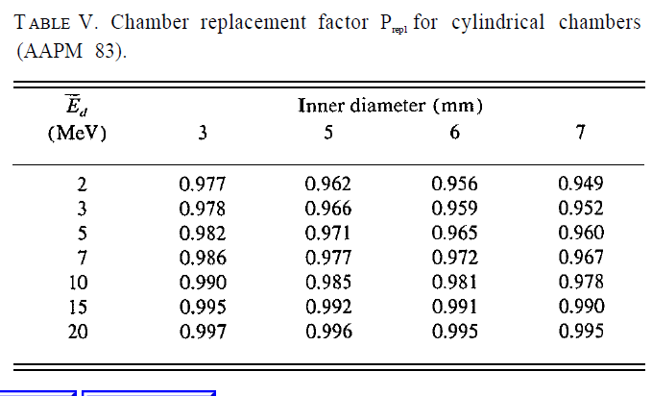
Converting PDI to PDD : Replacement factor
1st assumption : The cavity must not disturb the charged particle fluence existing in the medium in the absence of the cavity.
Not true! For cylindrical chambers, we must correct for changes to fluence as a function of using the cavity.
For cc13: radium = 3 mm.

Slide 20
Converting PDI to PDD : Stopping power ratio
Energy spectrum of the high-energy electron beam, unlike that of an x-ray beam decreases in energy rapidly with depth in the absorbing medium, with a consequent change in stopping power (significant for air) with depth.

